Slide 1

Lead score Model analysis
Submitted by
Manish Kotnala Anilan. M

Slide 2
Data analysis
The data set provide had information on 9240 leads that the company received and whether they converted or not.
Dropped Lead Number and Prospect ID as the values were unique.
Analyzed the percentage of null values in each column and dropped the rows with more than 45% null values.
Analyzed unique categories and found that max leads are received via google followed by direct traffic . The percentage of null values are minimal here and hence can be replaced with the max value- google. Also its interesting to see that Social media is very less relevant.
Since lead conversion from India is far higher than the rest of the categories its safe to drop them and focus on the city data.

Slide 3
We choose to keep the null values in specialization, occupation and tags and clubbed Retail ,Hospitality ,IT Projects ,Healthcare ,Supply Chain ,Finance ,Human Resource ,Marketing and Operations to a single category Management Specialization
subcategories with low frequencies can be replaced with others
Ratio of converting leads to successful is large in working professional
Unemployed type have largest number of leads but ration of conversion of Leads is almost 50%
Higher conversion rate was observed in leads who send an SMS.

Slide 4
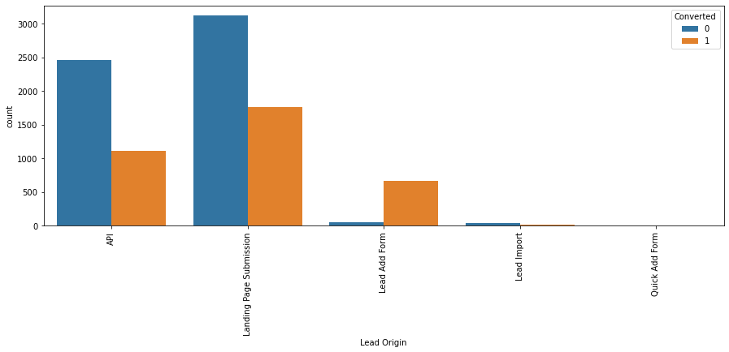
Analyzing lead origin
Lead Add Form submission Lead origin have highest ratio of conversion.
API and Landing Page Submission Lead origin have largest number of leads and conversions.
Lead origin with Lead add form have more conversion rate hence it should be given preference over other Lead origin.

Slide 5
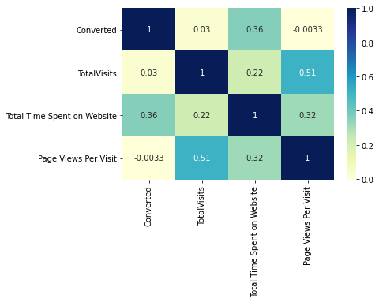
Analyzing correlation of numerical variables

Slide 6
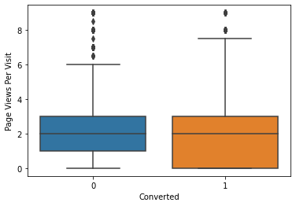
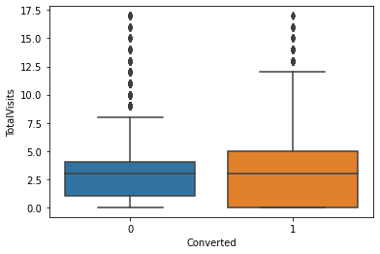
Outlier Analysis
Outliers were identified in total time spend and total visits columns. Removing them and comparing total visits to conversion shows that totla visits have a positive correlation with lead conversion.
Dummy variables were created for categories with yes/no classes and original columns were dropped.

Slide 7
Model Building
The data set was split to 70% training and 30% testing.
Lead Source_Referral Sites has a high p value and hance can be dropped.
Last Notable Activity_SMS Sent columns as it have high VIF value
Model Summary
Model accuracy in training set : 92%
Sensitivity : 0.882
Specificity : 0.95
False positive rate: 0.048
positive predictive value : 0.91
negative predictive value:0.92

Slide 8
Top 3 Factors effects the probability of conversion are
1. Tags_Closed by Horizzon
2. Tags_Lost to EINS
3. Tags_Will revert after reading the email

Slide 9
Top 3 Factors should be focused to improved the probability of the lead conversion
Tags_Ringing
Tags_OtherTags
3) Tags_Interested in other courses

Slide 10
Model performance on test data
Accuracy : 92%
True positive rate: 0.91
True negative rate :0.93
Precision: 89%
Recall : 91%

